Slide 1








Home
Design
Compound | Status | SMILE
Sn1151431838 | Design | Cc1cnc(c(c1OC)C)CS(=O)c2[BnH]Dc3cc(ccc3n2)O
Sn1400572741 | Backlog | O1C=C[C@H]([C@H]1O2)c3c2cc(OC)c4c3OC(=O)
Sn2852429942 | Finished | CC#CC[n](c([n]c1N(C(=O)N(C2=O)Cc([n]c(cccc3)
Sn4728964143 | Synthesis | CC1=C(C=C(C=C1)NC(=O)C2=CC=C(C=C2)CN3CC
Sn5626213214 | Testing | OCCc1c(C)[n+](cs1)Cc2cnc(C)nc2N
Sn6291073315 | Testing | Cn1cnc2n(C)c(=O)n(C)c(=O)c12
Sn6490551586 | Purification | CCc1nn(C)c2c(=O)[nH]c(nc12)c3cc(ccc3OCC)S(=
Sn6813063167 | Backlog | Cc1nnc2CN=C(c3ccccc3)c4cc(Cl)ccc4-n12
Sn7070574048 | Backlog | CN1C(=O)CN=C(c2ccccc2)c3cc(Cl)ccc13
Sn8908810359 | Testing | COc1ccc2[nH]c(nc2c1)S(=O)Cc3ncc(C)c(OC)c3C
Testing
Synthesis
Purification

Slide 2

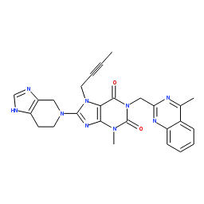
Design Hovered
Design
Compound | Status | SMILE
Sn1151431838 | Design | Cc1cnc(c(c1OC)C)CS(=O)c2[BnH]Dc3cc(ccc3n2)O
Testing
Synthesis
Purification

Slide 3
Design Clicked
Design
Compound | Status | SMILE
Sn1151431838 | Design | Cc1cnc(c(c1OC)C)CS(=O)c2[BnH]Dc3cc(ccc3n2)O
Testing
Synthesis
Purification

Slide 4

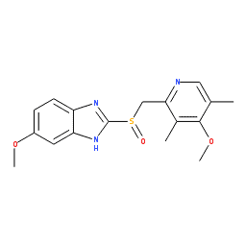
Synthesis Hovered
Design
Compound | Status | SMILE
Sn4728964143 | Synthesis | CC1=C(C=C(C=C1)NC(=O)C2=CC=C(C=C2)CN3CC
Testing
Synthesis
Purification

Slide 5
Synthesis Clicked
Design
Compound | Status | SMILE
Sn4728964143 | Synthesis | CC1=C(C=C(C=C1)NC(=O)C2=CC=C(C=C2)CN3CC
Testing
Synthesis
Purification

Slide 6
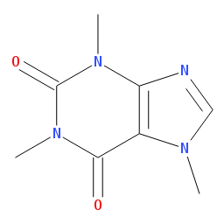

Purification Hovered
Design
Compound | Status | SMILE
Sn6490551586 | Purification | CCc1nn(C)c2c(=O)[nH]c(nc12)c3cc(ccc3OCC)S(=
Testing
Synthesis
Purification

Slide 7
Purification Clicked
Design
Compound | Status | SMILE
Sn6490551586 | Purification | CCc1nn(C)c2c(=O)[nH]c(nc12)c3cc(ccc3OCC)S(=
Testing
Synthesis
Purification

Slide 8

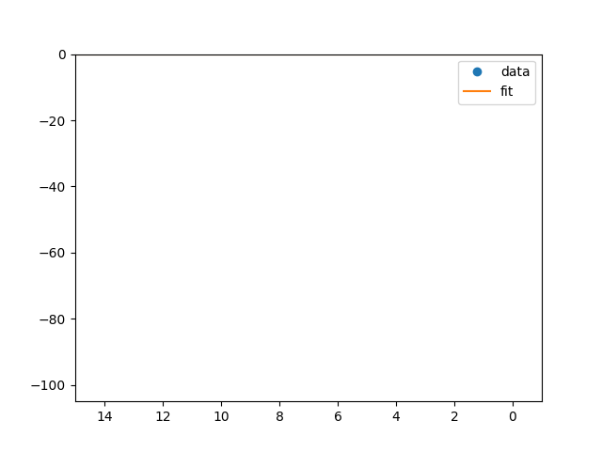
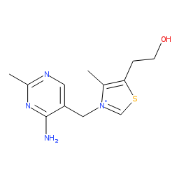
Testing Hovered
Design
Compound | Status | SMILE
Sn5626213214 | Testing | OCCc1c(C)[n+](cs1)Cc2cnc(C)nc2N
Sn6291073315 | Testing | Cn1cnc2n(C)c(=O)n(C)c(=O)c12
Sn8908810359 | Testing | COc1ccc2[nH]c(nc2c1)S(=O)Cc3ncc(C)c(OC)c3C
Testing
Synthesis
Purification

Slide 9
Testing Clicked - 1st Compound hovered
Design
Compound | Status | SMILE
Sn5626213214 | Testing | OCCc1c(C)[n+](cs1)Cc2cnc(C)nc2N
Sn6291073315 | Testing | Cn1cnc2n(C)c(=O)n(C)c(=O)c12
Sn8908810359 | Testing | COc1ccc2[nH]c(nc2c1)S(=O)Cc3ncc(C)c(OC)c3C
Testing
Synthesis
Purification

Slide 10
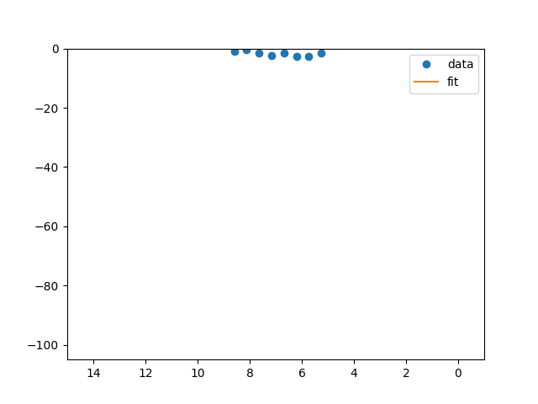
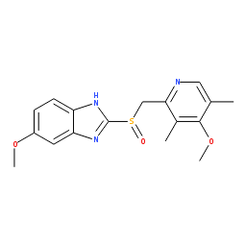
Testing Clicked - 2nd Compound hovered
Design
Compound | Status | SMILE
Sn5626213214 | Testing | OCCc1c(C)[n+](cs1)Cc2cnc(C)nc2N
Sn6291073315 | Testing | Cn1cnc2n(C)c(=O)n(C)c(=O)c12
Sn8908810359 | Testing | COc1ccc2[nH]c(nc2c1)S(=O)Cc3ncc(C)c(OC)c3C
Testing
Synthesis
Purification

Slide 11
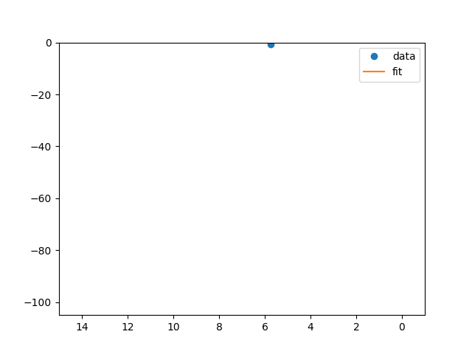
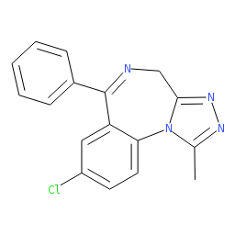
Testing Clicked – 3rd Compound hovered
Design
Compound | Status | SMILE
Sn5626213214 | Testing | OCCc1c(C)[n+](cs1)Cc2cnc(C)nc2N
Sn6291073315 | Testing | Cn1cnc2n(C)c(=O)n(C)c(=O)c12
Sn8908810359 | Testing | COc1ccc2[nH]c(nc2c1)S(=O)Cc3ncc(C)c(OC)c3C
Testing
Synthesis
Purification

Slide 12
1ST Compound (design) hovered
Design
Compound | Status | SMILE
Sn1151431838 | Design | Cc1cnc(c(c1OC)C)CS(=O)c2[BnH]Dc3cc(ccc3n2)O
Sn1400572741 | Backlog | O1C=C[C@H]([C@H]1O2)c3c2cc(OC)c4c3OC(=O)
Sn2852429942 | Finished | CC#CC[n](c([n]c1N(C(=O)N(C2=O)Cc([n]c(cccc3)
Sn4728964143 | Synthesis | CC1=C(C=C(C=C1)NC(=O)C2=CC=C(C=C2)CN3CC
Sn5626213214 | Testing | OCCc1c(C)[n+](cs1)Cc2cnc(C)nc2N
Sn6291073315 | Testing | Cn1cnc2n(C)c(=O)n(C)c(=O)c12
Sn6490551586 | Purification | CCc1nn(C)c2c(=O)[nH]c(nc12)c3cc(ccc3OCC)S(=
Sn6813063167 | Backlog | Cc1nnc2CN=C(c3ccccc3)c4cc(Cl)ccc4-n12
Sn7070574048 | Backlog | CN1C(=O)CN=C(c2ccccc2)c3cc(Cl)ccc13
Sn8908810359 | Testing | COc1ccc2[nH]c(nc2c1)S(=O)Cc3ncc(C)c(OC)c3C
Testing
Synthesis
Purification

Slide 13
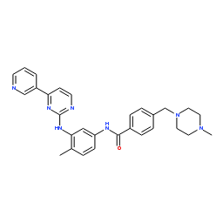
2nd Compound (backlog) hovered
Design
Compound | Status | SMILE
Sn1151431838 | Design | Cc1cnc(c(c1OC)C)CS(=O)c2[BnH]Dc3cc(ccc3n2)O
Sn1400572741 | Backlog | O1C=C[C@H]([C@H]1O2)c3c2cc(OC)c4c3OC(=O)
Sn2852429942 | Finished | CC#CC[n](c([n]c1N(C(=O)N(C2=O)Cc([n]c(cccc3)
Sn4728964143 | Synthesis | CC1=C(C=C(C=C1)NC(=O)C2=CC=C(C=C2)CN3CC
Sn5626213214 | Testing | OCCc1c(C)[n+](cs1)Cc2cnc(C)nc2N
Sn6291073315 | Testing | Cn1cnc2n(C)c(=O)n(C)c(=O)c12
Sn6490551586 | Purification | CCc1nn(C)c2c(=O)[nH]c(nc12)c3cc(ccc3OCC)S(=
Sn6813063167 | Backlog | Cc1nnc2CN=C(c3ccccc3)c4cc(Cl)ccc4-n12
Sn7070574048 | Backlog | CN1C(=O)CN=C(c2ccccc2)c3cc(Cl)ccc13
Sn8908810359 | Testing | COc1ccc2[nH]c(nc2c1)S(=O)Cc3ncc(C)c(OC)c3C
Testing
Synthesis
Purification

Slide 14
2nd Compound (backlog) clicked
Design
Compound | Status | SMILE
Sn1400572741 | Backlog | O1C=C[C@H]([C@H]1O2)c3c2cc(OC)c4c3OC(=O)
Testing
Synthesis
Purification

Slide 15
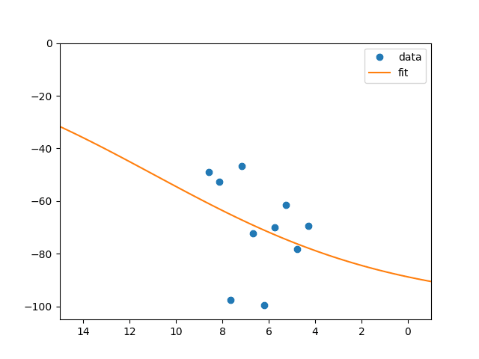
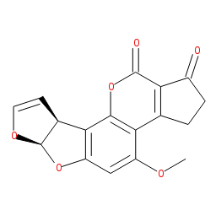
3rd Compound (finished) hovered
Design
Compound | Status | SMILE
Sn1151431838 | Design | Cc1cnc(c(c1OC)C)CS(=O)c2[BnH]Dc3cc(ccc3n2)O
Sn1400572741 | Backlog | O1C=C[C@H]([C@H]1O2)c3c2cc(OC)c4c3OC(=O)
Sn2852429942 | Finished | CC#CC[n](c([n]c1N(C(=O)N(C2=O)Cc([n]c(cccc3)
Sn4728964143 | Synthesis | CC1=C(C=C(C=C1)NC(=O)C2=CC=C(C=C2)CN3CC
Sn5626213214 | Testing | OCCc1c(C)[n+](cs1)Cc2cnc(C)nc2N
Sn6291073315 | Testing | Cn1cnc2n(C)c(=O)n(C)c(=O)c12
Sn6490551586 | Purification | CCc1nn(C)c2c(=O)[nH]c(nc12)c3cc(ccc3OCC)S(=
Sn6813063167 | Backlog | Cc1nnc2CN=C(c3ccccc3)c4cc(Cl)ccc4-n12
Sn7070574048 | Backlog | CN1C(=O)CN=C(c2ccccc2)c3cc(Cl)ccc13
Sn8908810359 | Testing | COc1ccc2[nH]c(nc2c1)S(=O)Cc3ncc(C)c(OC)c3C
Testing
Synthesis
Purification

Slide 16
3rd Compound (finished) clicked
Design
Compound | Status | SMILE
Sn2852429942 | Finished | CC#CC[n](c([n]c1N(C(=O)N(C2=O)Cc([n]c(cccc3)
Testing
Synthesis
Purification

Slide 17
4th Compound (synthesis) hovered
Design
Compound | Status | SMILE
Sn1151431838 | Design | Cc1cnc(c(c1OC)C)CS(=O)c2[BnH]Dc3cc(ccc3n2)O
Sn1400572741 | Backlog | O1C=C[C@H]([C@H]1O2)c3c2cc(OC)c4c3OC(=O)
Sn2852429942 | Finished | CC#CC[n](c([n]c1N(C(=O)N(C2=O)Cc([n]c(cccc3)
Sn4728964143 | Synthesis | CC1=C(C=C(C=C1)NC(=O)C2=CC=C(C=C2)CN3CC
Sn5626213214 | Testing | OCCc1c(C)[n+](cs1)Cc2cnc(C)nc2N
Sn6291073315 | Testing | Cn1cnc2n(C)c(=O)n(C)c(=O)c12
Sn6490551586 | Purification | CCc1nn(C)c2c(=O)[nH]c(nc12)c3cc(ccc3OCC)S(=
Sn6813063167 | Backlog | Cc1nnc2CN=C(c3ccccc3)c4cc(Cl)ccc4-n12
Sn7070574048 | Backlog | CN1C(=O)CN=C(c2ccccc2)c3cc(Cl)ccc13
Sn8908810359 | Testing | COc1ccc2[nH]c(nc2c1)S(=O)Cc3ncc(C)c(OC)c3C
Testing
Synthesis
Purification

Slide 18
5th Compound (testing) hovered
Design
Compound | Status | SMILE
Sn1151431838 | Design | Cc1cnc(c(c1OC)C)CS(=O)c2[BnH]Dc3cc(ccc3n2)O
Sn1400572741 | Backlog | O1C=C[C@H]([C@H]1O2)c3c2cc(OC)c4c3OC(=O)
Sn2852429942 | Finished | CC#CC[n](c([n]c1N(C(=O)N(C2=O)Cc([n]c(cccc3)
Sn4728964143 | Synthesis | CC1=C(C=C(C=C1)NC(=O)C2=CC=C(C=C2)CN3CC
Sn5626213214 | Testing | OCCc1c(C)[n+](cs1)Cc2cnc(C)nc2N
Sn6291073315 | Testing | Cn1cnc2n(C)c(=O)n(C)c(=O)c12
Sn6490551586 | Purification | CCc1nn(C)c2c(=O)[nH]c(nc12)c3cc(ccc3OCC)S(=
Sn6813063167 | Backlog | Cc1nnc2CN=C(c3ccccc3)c4cc(Cl)ccc4-n12
Sn7070574048 | Backlog | CN1C(=O)CN=C(c2ccccc2)c3cc(Cl)ccc13
Sn8908810359 | Testing | COc1ccc2[nH]c(nc2c1)S(=O)Cc3ncc(C)c(OC)c3C
Testing
Synthesis
Purification

Slide 19
5th Compound (testing) clicked
Design
Compound | Status | SMILE
Sn5626213214 | Testing | OCCc1c(C)[n+](cs1)Cc2cnc(C)nc2N
Testing
Synthesis
Purification

Slide 20
6th Compound (testing) hovered
Design
Compound | Status | SMILE
Sn1151431838 | Design | Cc1cnc(c(c1OC)C)CS(=O)c2[BnH]Dc3cc(ccc3n2)O
Sn1400572741 | Backlog | O1C=C[C@H]([C@H]1O2)c3c2cc(OC)c4c3OC(=O)
Sn2852429942 | Finished | CC#CC[n](c([n]c1N(C(=O)N(C2=O)Cc([n]c(cccc3)
Sn4728964143 | Synthesis | CC1=C(C=C(C=C1)NC(=O)C2=CC=C(C=C2)CN3CC
Sn5626213214 | Testing | OCCc1c(C)[n+](cs1)Cc2cnc(C)nc2N
Sn6291073315 | Testing | Cn1cnc2n(C)c(=O)n(C)c(=O)c12
Sn6490551586 | Purification | CCc1nn(C)c2c(=O)[nH]c(nc12)c3cc(ccc3OCC)S(=
Sn6813063167 | Backlog | Cc1nnc2CN=C(c3ccccc3)c4cc(Cl)ccc4-n12
Sn7070574048 | Backlog | CN1C(=O)CN=C(c2ccccc2)c3cc(Cl)ccc13
Sn8908810359 | Testing | COc1ccc2[nH]c(nc2c1)S(=O)Cc3ncc(C)c(OC)c3C
Testing
Synthesis
Purification

Slide 21
6th Compound (testing) clicked
Design
Compound | Status | SMILE
Sn6291073315 | Testing | Cn1cnc2n(C)c(=O)n(C)c(=O)c12
Testing
Synthesis
Purification

Slide 22
7th Compound (purification) hovered
Design
Compound | Status | SMILE
Sn1151431838 | Design | Cc1cnc(c(c1OC)C)CS(=O)c2[BnH]Dc3cc(ccc3n2)O
Sn1400572741 | Backlog | O1C=C[C@H]([C@H]1O2)c3c2cc(OC)c4c3OC(=O)
Sn2852429942 | Finished | CC#CC[n](c([n]c1N(C(=O)N(C2=O)Cc([n]c(cccc3)
Sn4728964143 | Synthesis | CC1=C(C=C(C=C1)NC(=O)C2=CC=C(C=C2)CN3CC
Sn5626213214 | Testing | OCCc1c(C)[n+](cs1)Cc2cnc(C)nc2N
Sn6291073315 | Testing | Cn1cnc2n(C)c(=O)n(C)c(=O)c12
Sn6490551586 | Purification | CCc1nn(C)c2c(=O)[nH]c(nc12)c3cc(ccc3OCC)S(=
Sn6813063167 | Backlog | Cc1nnc2CN=C(c3ccccc3)c4cc(Cl)ccc4-n12
Sn7070574048 | Backlog | CN1C(=O)CN=C(c2ccccc2)c3cc(Cl)ccc13
Sn8908810359 | Testing | COc1ccc2[nH]c(nc2c1)S(=O)Cc3ncc(C)c(OC)c3C
Testing
Synthesis
Purification

Slide 23
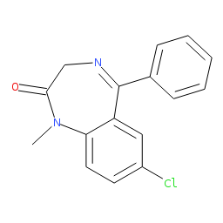
8th Compound (backlog) hovered
Design
Compound | Status | SMILE
Sn1151431838 | Design | Cc1cnc(c(c1OC)C)CS(=O)c2[BnH]Dc3cc(ccc3n2)O
Sn1400572741 | Backlog | O1C=C[C@H]([C@H]1O2)c3c2cc(OC)c4c3OC(=O)
Sn2852429942 | Finished | CC#CC[n](c([n]c1N(C(=O)N(C2=O)Cc([n]c(cccc3)
Sn4728964143 | Synthesis | CC1=C(C=C(C=C1)NC(=O)C2=CC=C(C=C2)CN3CC
Sn5626213214 | Testing | OCCc1c(C)[n+](cs1)Cc2cnc(C)nc2N
Sn6291073315 | Testing | Cn1cnc2n(C)c(=O)n(C)c(=O)c12
Sn6490551586 | Purification | CCc1nn(C)c2c(=O)[nH]c(nc12)c3cc(ccc3OCC)S(=
Sn6813063167 | Backlog | Cc1nnc2CN=C(c3ccccc3)c4cc(Cl)ccc4-n12
Sn7070574048 | Backlog | CN1C(=O)CN=C(c2ccccc2)c3cc(Cl)ccc13
Sn8908810359 | Testing | COc1ccc2[nH]c(nc2c1)S(=O)Cc3ncc(C)c(OC)c3C
Testing
Synthesis
Purification

Slide 24
8th Compound (backlog) clicked
Design
Compound | Status | SMILE
Sn6813063167 | Backlog | Cc1nnc2CN=C(c3ccccc3)c4cc(Cl)ccc4-n12
Testing
Synthesis
Purification

Slide 25
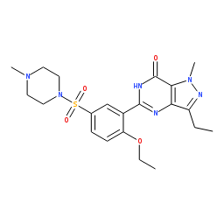
9th Compound (backlog) hovered
Design
Compound | Status | SMILE
Sn1151431838 | Design | Cc1cnc(c(c1OC)C)CS(=O)c2[BnH]Dc3cc(ccc3n2)O
Sn1400572741 | Backlog | O1C=C[C@H]([C@H]1O2)c3c2cc(OC)c4c3OC(=O)
Sn2852429942 | Finished | CC#CC[n](c([n]c1N(C(=O)N(C2=O)Cc([n]c(cccc3)
Sn4728964143 | Synthesis | CC1=C(C=C(C=C1)NC(=O)C2=CC=C(C=C2)CN3CC
Sn5626213214 | Testing | OCCc1c(C)[n+](cs1)Cc2cnc(C)nc2N
Sn6291073315 | Testing | Cn1cnc2n(C)c(=O)n(C)c(=O)c12
Sn6490551586 | Purification | CCc1nn(C)c2c(=O)[nH]c(nc12)c3cc(ccc3OCC)S(=
Sn6813063167 | Backlog | Cc1nnc2CN=C(c3ccccc3)c4cc(Cl)ccc4-n12
Sn7070574048 | Backlog | CN1C(=O)CN=C(c2ccccc2)c3cc(Cl)ccc13
Sn8908810359 | Testing | COc1ccc2[nH]c(nc2c1)S(=O)Cc3ncc(C)c(OC)c3C
Testing
Synthesis
Purification

Slide 26
9th Compound (backlog) clicked
Design
Compound | Status | SMILE
Sn7070574048 | Backlog | CN1C(=O)CN=C(c2ccccc2)c3cc(Cl)ccc13
Testing
Synthesis
Purification

Slide 27
10th Compound (testing) hovered
Design
Compound | Status | SMILE
Sn1151431838 | Design | Cc1cnc(c(c1OC)C)CS(=O)c2[BnH]Dc3cc(ccc3n2)O
Sn1400572741 | Backlog | O1C=C[C@H]([C@H]1O2)c3c2cc(OC)c4c3OC(=O)
Sn2852429942 | Finished | CC#CC[n](c([n]c1N(C(=O)N(C2=O)Cc([n]c(cccc3)
Sn4728964143 | Synthesis | CC1=C(C=C(C=C1)NC(=O)C2=CC=C(C=C2)CN3CC
Sn5626213214 | Testing | OCCc1c(C)[n+](cs1)Cc2cnc(C)nc2N
Sn6291073315 | Testing | Cn1cnc2n(C)c(=O)n(C)c(=O)c12
Sn6490551586 | Purification | CCc1nn(C)c2c(=O)[nH]c(nc12)c3cc(ccc3OCC)S(=
Sn6813063167 | Backlog | Cc1nnc2CN=C(c3ccccc3)c4cc(Cl)ccc4-n12
Sn7070574048 | Backlog | CN1C(=O)CN=C(c2ccccc2)c3cc(Cl)ccc13
Sn8908810359 | Testing | COc1ccc2[nH]c(nc2c1)S(=O)Cc3ncc(C)c(OC)c3C
Testing
Synthesis
Purification

Slide 28
10th Compound (testing) clicked
Design
Compound | Status | SMILE
Sn8908810359 | Testing | COc1ccc2[nH]c(nc2c1)S(=O)Cc3ncc(C)c(OC)c3C
Testing
Synthesis
Purification

